Slide 1
Preventing and Reducing Pollution From MS4 Activities
GCSA Employee Training
Nienhuis Park Community Center
May 19, 2017
Richard Smith, Stormwater Consultant

Slide 2
Training About “MS4 Activities” Pollution
OKR04 Part IV.C.6.a “…and continue to implement and enforce the operation and maintenance program that includes a training component … [to address] pollutant runoff from MS4 operations.” [Required]
OKR04 Part IV.C.6.a(2) “Implement a municipal employee training and education program that you will use to prevent and reduce stormwater pollution from MS4 activities. ...” [Required]
What are “MS4 Activities”? This wrap-up presentation will address MS4 activities not yet covered today.

Slide 3
MS4 Activities & Operations Covered Today
Material storage and disposal of wastes (4).
Park and open space maintenance (6).
Municipal fleet and building maintenance (7).
Construction and land disturbance (8).
MS4 maintenance (streets and drainage systems) (9).
Illegal discharges (hazards, identifying & reporting) (3 and 5).

Slide 4
Other Types of MS4 Activities & Operations
Municipal pools and splash pads.
Municipal lakes and ponds.
Wastewater treatment plants (WWTPs).
Water treatment plants and other utilities.
Municipal landfills.
Municipal stormwater / flood control structures.
Municipal LID structures.

Slide 5
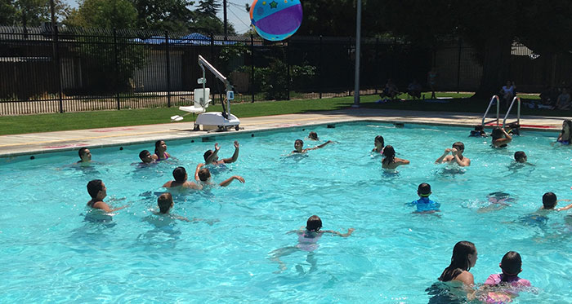
Municipal Pools
Possible ways pollutants can enter stormwater runoff from municipal pools:
Piping pool water into stormdrains, streets or creeks.
Backwash water piped to storm drains, streets or creeks.
Leaks from plumbing.
Chemical spills.
Vandalism.

Slide 6
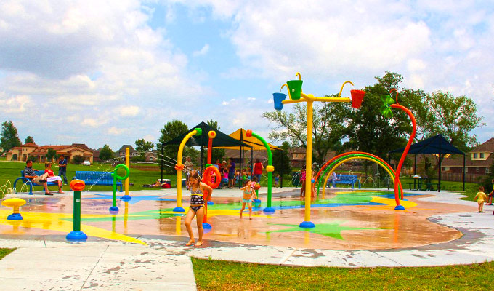
Municipal Splash Pads
Three types:
Flow-Through (tap water to sanitary sewer).
Recirculate (capture, treat, Reuse).
Irrigation (capture, pipe to irrigation fields or gardens).
Nearly all in Tulsa county are flow-through.
Pathogens associated with splash pads and runoff:
Naegleria fowleri
Cryptosporidium
Bacteria pathogens

Slide 7
Municipal Splash Pads
2010 Oklahoma Legislature exempted splash pads from safety and testing regulations for swimming pools.
No state testing program now; municipals only.
Water on the pads can be contaminated.
Runoff into shallow pools of water and mud by pads can be contaminated.
2005 Mohawk Park shallow pools by splash pad where allegedly 2 boys died from Naegleria.
Over-chlorination can also cause polluted runoff.

Slide 8
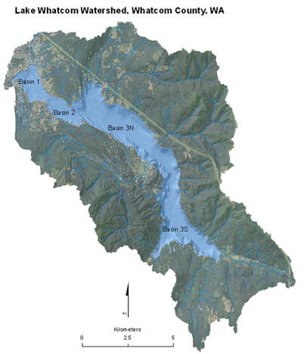
Municipal Lakes and Ponds
Are not pollution sources; are areas to be protected.
Pollution can come from entire watershed, but mainly from near shoreline and tributaries.
Most city limits cover only the waterbody and a narrow buffer around the waterbody.
Most common lake impairments:
Dissolved oxygen
pH
Nutrients
Turbidity

Slide 9
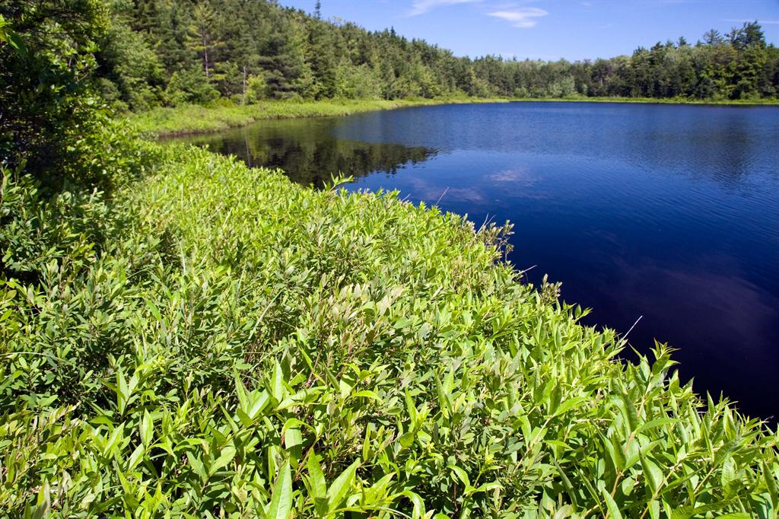
Typical BMPs for Municipal Lakes
Bank and shoreline stabilization and erosion control.
Vegetative cover; forest management.
Pervious surfaces for parking lots, paths.
Near shore emergent aquatic plants as buffers.
Public education about trash, fish offal, food waste.
Control of fertilizers, pesticides and other chemicals.
Mechanical aeration of water column.
Organized lake cleanups and environmental events.

Slide 10
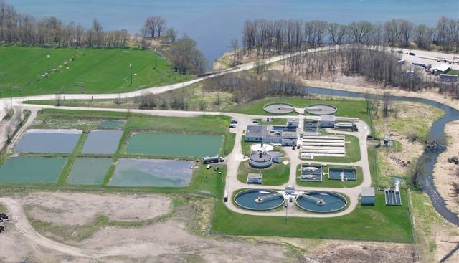
Wastewater Treatment and Water Plants
OKR05 covers WWTPs >1 MGD.
OKR04 covers WWTPs <1 MGD.
Use standard facility BMPs.
MS4 stormwater managers should work with WWTP operators and superintendents on OKR05 compliance.
Water plants are not covered by OKR05; OKR04 applies.
Use standard facility BMPs.
Other municipal utilities are covered under OKR04.
Part of 6th MCM (Good Housekeeping).

Slide 11
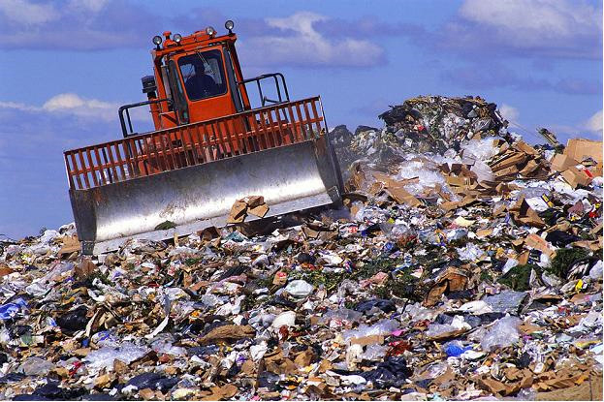
Municipal Landfills
OKR05 covers “Stormwater discharges from facilities associated with waste disposal at landfills, and land application sites that receive or have received industrial waste, including sites subject to regulation under Subtitle D of RCRA, are covered under Sector L.”
OKR04 covers all other municipal landfills not covered by OKR05 (covered as 6th MCM).
Use standard facility BMPs.

Slide 12
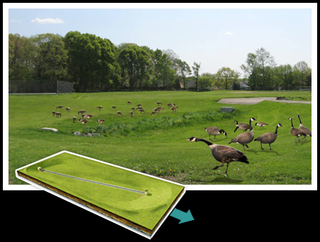
Stormwater and Flood Control Structures
Most basins are dry, some have permanent water.
Pollution from basins must be controlled by:
Control pollutant inflow (nutrients, sediment, toxics).
Control pollutant generation within basin.
Pollution into basins must be controlled by:
6th MCM BMPs in basin drainage.
Public & HOA education.
Inspect stormwater structures.

Slide 13
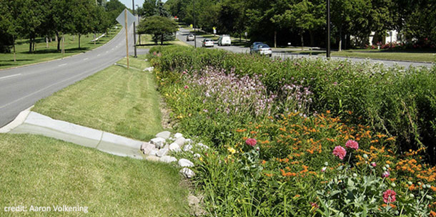
Municipal LID Structures
MS4 LID must be maintained.
MS4 inspection & authority.
MS4 dedicated resources.
Falls under OKR04’s 5th MCM (Post-Construction) and 6th MCM (Good Housekeeping).
Types of MS4-Owned LID include:
WQ detention basins, rain gardens, wetlands.
Green roofs.
Permeable pavement types.

Slide 14
Questions ??
Vernon Seaman
Manager, Envir. And Energy Planning
INCOG
Two West 2nd Street, Ste 800
Tulsa, OK 74103
(918) 579-9451
vseaman@incog.org

